Slide 1


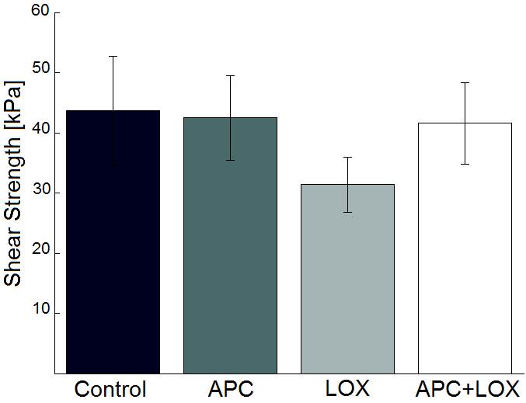
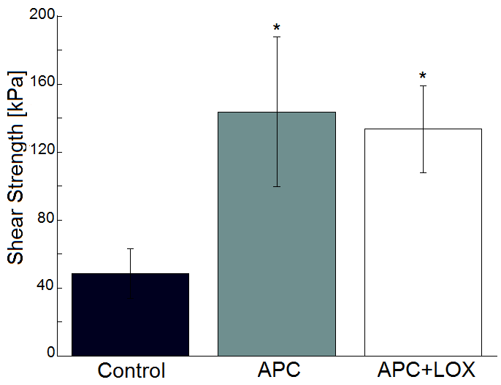
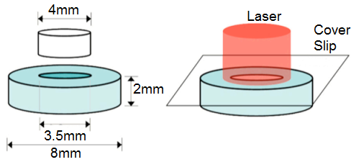
The effects of Lysyl Oxidase and APC photochemical
bonding on articular cartilage integration
Aristos Athens¹, Chunhua Zheng¹, Alberto Arvayo¹, Aliyeh Mousavi¹, Marc Levenston¹
1. Biomechanical Engineering, Stanford University
Introduction
Cartilage lesions cause joints to degenerate into osteoarthritis, a disease affecting over a third of adults aged 65¹. It is a significant problem that needs to be addressed.
To achieve long-term, durable repair of articular cartilage, implanted cartilage needs to be integrated with native tissue.
This project examined two factors:
Lysyl Oxidase (LOX): A metalloenzyme that converts amine side-chains of lysine and hydroxylysine into aldehydes that then form cross-link bonds² between collagen fibers.
Aluminum Phthalocyanine Chloride (APC): A photo-sensitizer that consumes environmental oxygen and forms cross-links when irradiated.
Hypothesis: LOX and APC treatments will be effective in achieving integration between native-to-native articular cartilage surfaces (i.e. non tissue-engineered cartilage). Hypothesis tested via two experiments:
1st experiment: APC treatment, plus a two week culture period in LOX supplemented medium. Push-out test performed on day 14.
2nd experiment: APC treatment at 20x concentration, plus four hour LOX application at 100x concentration. No culture period. Push-out test performed on day 0.
Materials and Methods
Discussion/Conclusion
In experiment 1, neither the APC treatment nor the LOX treatment affected interfacial strength. In exp2, the APC treatment produced statistically significant increases in mechanical properties, but the combined APC/LOX group was not different from the APC group.
In exp1, the APC concentration was 0.25 mM. In exp2, the APC concentration was 5 mM. The low concentration may explain why APC was not effective in in exp1.
LOX has been shown to improve mechanical properties at engineered-to-native cartilage interfaces, cultured for 2-6 wks³. These experiment show that either LOX is not effective for native tissue, or the culture period was too short, or both.
LOX may have been less effective than in previous studies because chondrocytes in native tissue are not as metabolically active as those in self-assembled neocartilage. Additionally, a 2 wk culture period is likely not long enough for crosslinks to form.
References
1. Athanasiou, et al. Electronic reference: Morgan & Claypool. 2009
2. Eyre, et al. Annual Rev Biochem; 53:717-48, 1984
3. Athens, et al. PLoS ONE; 10.1371/journal. pone.0060719, 2013
Hyaline cartilage extracted from juvenile bovine knees. For all groups, n=8 samples. 6 samples are used for mechanical testing, 2 samples for histological analysis.
Chondtroininase treatment of plugs for 15 min. This digests some of the negatively charged proteoglycans.
APC Treatment/Press-fit: Plugs are dipped into an APC solution for 20 sec. They are then pushed into the annuli and held for 30 sec. Samples are then irradiated for 10 min. In experiment 1, 0.25 mM APC was used. In experiment 2, 5 mM APC was used.
LOX application for differing durations. The “Lysyl Oxidase Like-2” (LOXL2) enzyme was used.
Mechanical testing via push-out test and histological assessment. Statistical analysis done with Tukey’s test (p<0.05). Results are presented as mean ± standard error.
Results
Fig.2: In experiment 1, there was no statistical difference between any of the groups. APC did not significantly change bond strength at the given concentration. LOX had no measurable effect.
Fig.3: In experiment 2, both APC treated groups were significantly higher than the control. LOX had no measurable effect.
Fig.1:
Annulus/plug diagram
and laser treatment.

